Slide 2

Loan Application
February 02, 2024

Slide 3
Agenda
Objective
Problem Statement
Implementation
Input & Output

Slide 4
The primary aim of this project is to create a console-based NodeJS application for Loan Application . It enables users to Submit the details for Loan approval. Here I am taking input as First name, Last name, Father Name and Company Name etc. After successful submission of user details, we can get all the details which were entered by user for preview.
Objective

Slide 5
Problem Statement
Design a simple console-based NodeJS program for a Loan Application. The program should allow users to enter the details for Loan approval. We have to get information like First Name, Last Name, Father Name, Company Name and ID number etc. This level aims to provide a foundational understanding of NodeJS programming and basic user interactions.

Slide 6
Concepts
This program is using the built-in Node.js library 'readline', which allows us to read input from the command line interface.
Promises - Promises are used to handle asynchronous operations in a more readable and maintainable way. In this program, here I’m using promises to handle the user input.
Regular expressions - Regular expressions are patterns used to match character combinations in strings. In this program, we are using regular expressions to validate the user input.

Slide 7
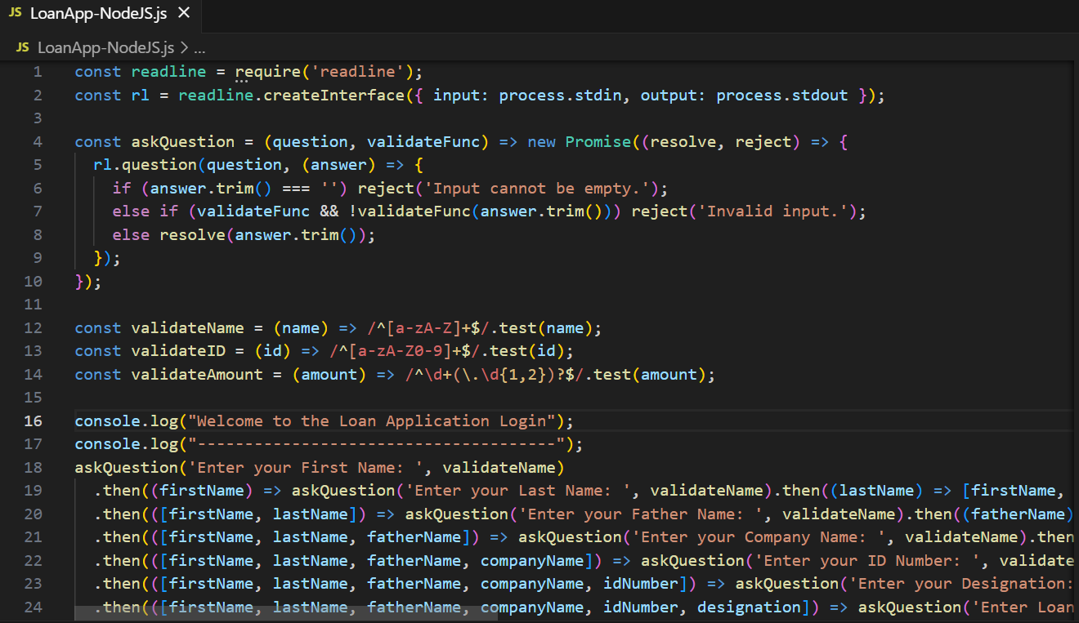
Logic

Slide 8
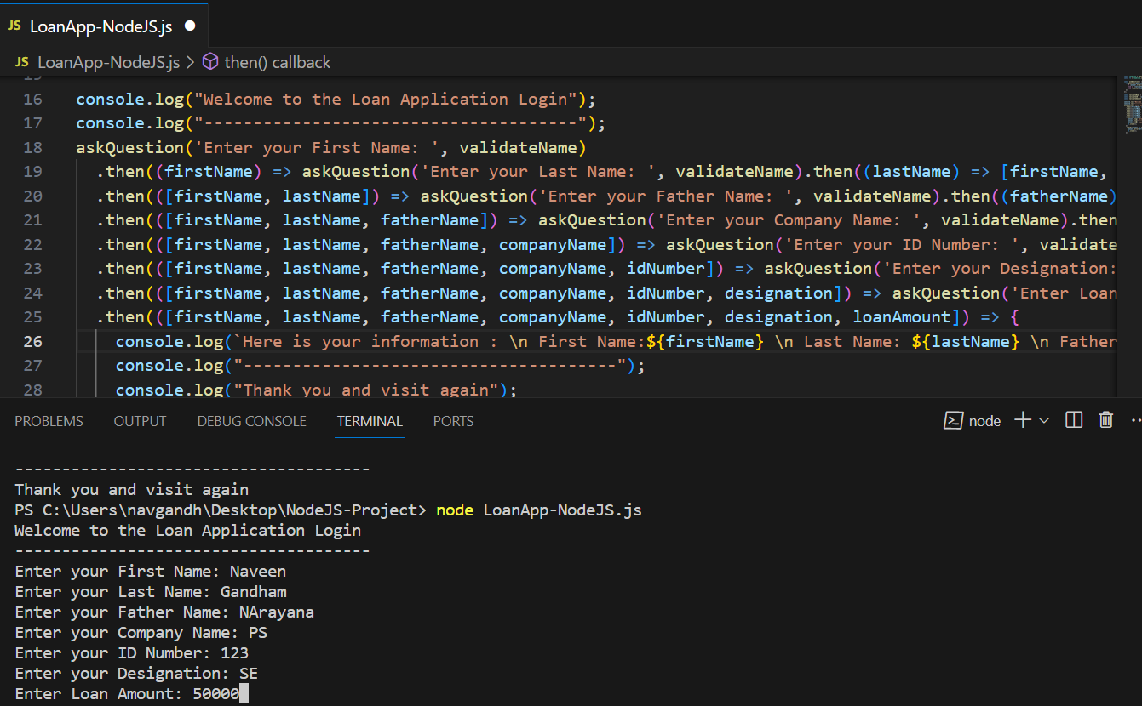
Input

Slide 9
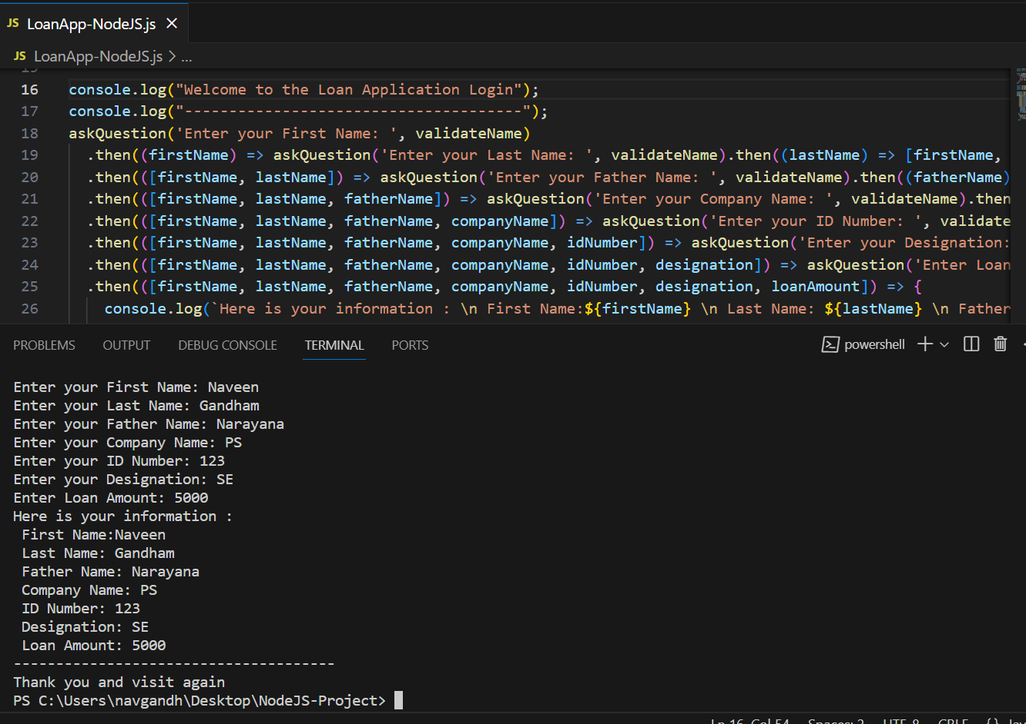
Output

